Slide 1
Scientific Session Moderator Training
ACVIM Staff

Slide 2
Objectives
THE THREE “R’s”
This training is about:
Responsibilities of the session moderator
AV tech response and how to get in contact with them
Resources specifically for moderators
Notes:
The goal of this moderator training is to help you understand the responsibilities that are required of you. In addition, it will point out the resources that are specific to Scientific Sessions.

Slide 3
Responsibilities
BEFORE SESSION
Visit the Speaker Headquarters, located at the Convention Center in room 6A
Locate or prepare a brief speaker introduction
Review the speaker introduction (this should be an abbreviated version of a speaker biography and found in the mobile app)
If no speaker biography is available, please touch base with the speaker prior to the sessions start to confirm their details
For multi-speaker or panel sessions, please confirm with speakers or panel chair how the introduction flow will work
If a session is sponsored, please include an acknowledgment in your introduction
Confirm with speakers how tracking of time will be communicated
Notes:
Before it’s time to moderate your session, please make sure you know how to introduce the speaker(s). All submitted speaker biographies will be available in advance. If your speaker biography is not listed in the ACVIM materials, you can find the speaker biographies using the mobile app or touch base in advance with the speakers (through the app) to confirm their information. Please edit longer biographies as needed, a good introduction is 3 sentences or less. To find people in the mobile app, login as instructed via email communications and select the People tab. Find your speaker’s name and the biography will appear, if they submitted one. If no biography is provided, please touch base with the speaker in advance to develop one.
In preparation for your session introductions, please check the online schedule, printed event program or mobile app to determine if your session is sponsored and include a recognition in your introductory remarks.
Also, please pick up timing cards (if you want to) at the Speaker Headquarters to help keep the speaker on time.
And please know, there will be an ACVIM representative in the Speaker Headquarters to assist with any questions you might have.

Slide 4
Responsibilities
PRIOR TO SESSION START
Arrive at session room at least 15-20 minutes early
Check-in with speaker(s)
Confirm name pronunciations and clarify introduction flow for multi-speaker and panel sessions and confirm bio(s)
Ask if questions will be allowed during or at end of presentation and indicate use of microphones in room to pose questions to capture the audio
Remind the speaker the Q&A portion is included in the session timing
Review how you will communicate upcoming session end timing to keep on schedule
Notes:
Please arrive at the session room at least 15-20 minutes early. You may have to wait in the hall until the room clears out but it’s better to be early than late in this situation. When the room is clear you can check to make sure everything looks in order and that the screen is projecting an image and that the podium microphone is on and locate the wireless lavaliere.
You also want to check-in with the speaker before the session begins. Make sure you have the pronunciation of his/her name correct. Find out if the speaker wants to take questions during the session or save them for the end during a Q&A. Explain the timing cards you will use to signal the end of the session.
If you find a problem, please contact AV through the help button on the presenter computer, speaking with the AV technician that is located in the hallway outside of the presentation room, or following the sign located in the hallway with AV contact information. An appropriate staff person will come to the room and help fix the problem.

Slide 5
Troubleshooting
HOW TO CONTACT AV
Potential Issues
AV issues
Speaker concerns
Room filling for potential overflow
Our AV technicians can be contacted in a variety of ways:
If you experience issues as the session is being set up, press the tech alert button on the laptop in the room. This will ask you to type in the issue and will immediately report the issue and room number to the AV team
Check the hallway for a roaming AV technician stationed in the hallway outside of the presentation room
Text or step outside the room and call our AV tech line at 512.655.3774 and notify of the room and issue.
Please note: Room layouts cannot be changed – these are set to accommodate the rooms for the week.
Notes:
The AV team is hear to assist and there are 3 ways to connect. The tech alert button on the presentation computer, roaming AV technicians in the hallways or by texting the AV line at 512.655.3774.

Slide 6
Responsibilities
AS ATTENDEES ARRIVE
As the room starts filling and concerns arise about potential overflow of room capacity
Notify AV of a potential overflow room
Make an announcement for people to move in and up to fill to their comfort level
AV staff will arrive to assist and direct people to overflow viewing if needed.
Notes:
If the room begins to fill and it looks as if there will be more people than seats, contact the AV staff immediately. The AV staff will monitor the situation and direct attendees to an overflow room where they will be able to hear the presentation.

Slide 7
Responsibilities
START OF SESSION
Welcome
Introduce yourself as moderator (name only)
Thank session sponsors (if any)
Ask attendees to turn cell phones to vibrate
Identify exits paths
Introduce speaker(s)
Notes:
Your opening sets the tone for the session. Please welcome the attendees and briefly introduce yourself by giving your name. If the session is sponsored, please thank them. For example you could say something like “I would like to thank XYZ company for sponsoring this session.” Remind the attendees to turn their cell phones to vibrate and inform them when they can ask questions. Please note: there are some sessions that have interactive components located inside the mobile app. As a safety moment, please note to locate the closest exit paths.
Next, give a brief introduction of the speaker(s). Once the introductions are complete, you can turn the session over to the speaker by saying something like “And now, please welcome ……”

Slide 8
Responsibilities
DURING THE SESSION
Troubleshoot as issues arise
Keep session on time
AFTER THE SESSION
Thank session sponsors and speakers
Remind attendees to complete session evaluations located in mobile app – this is critical to help the planning groups identify relevant content for the program.
Tell attendees to check out the Solutions Center (Thursdays and Fridays)
Complete the session evaluation
Notes:
At the end of the session, make sure to thank any sponsors and the speakers. Remind the attendees to complete the session evaluations. The session evaluations are in the mobile app. Also, on Thursday and Friday, you can recommend attendees to check out the Solutions Center (ACVIM term for the Exhibit Hall) or understand what is happening that day or at the end of your sessions.
You should then complete the session evaluation.

Slide 9
Livestreaming
LIMITED LIVESTREAMING
A limited number of sessions will be livestreamed from Austin, Texas and available for virtual participation.
Each livestreamed session will have an ACVIM staff member as a virtual moderator, please connect with them prior to the start of the session.
Notes:
A handful of sessions will be livestreamed from Austin to the virtual audience. Each livestreamed session will have an ACVIM staff member to assist. Please touch base with the staff member prior to the start of the session.

Slide 10
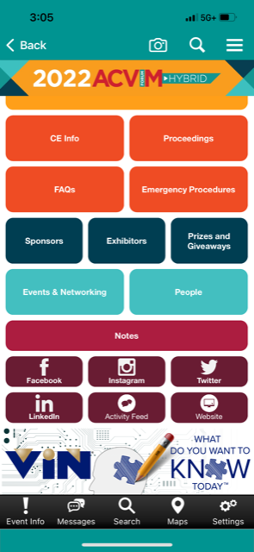
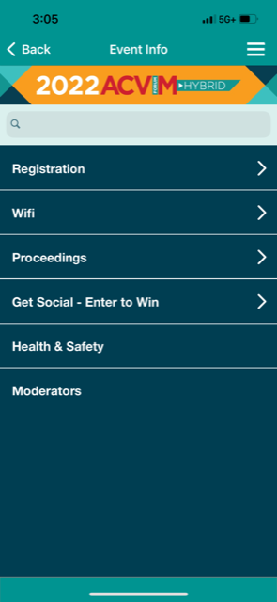
Resources
WEB PAGE
MOBILE APP
Please review the information on the Moderator Information Web Page and bookmark the page for ease of use onsite.
Notes:
ACVIM staff has created many resources to help with your moderating experience. You can find the resources on the moderator webpage or the mobile app by clicking Event Info and select the Moderator link.
From here you can open a sample moderator script, moderator instructions, and more.

Slide 11
Resources
Questions?
Thank you for assisting with this essential duty and don’t forget to visit the Speaker Headquarters in ACC 6A.
Notes:
If you have additional questions, stop in the Speaker Headquarters and speak with ACVIM staff and AV assistance. And remember, the Speaker Headquarters is for you too. You can stop by for a refreshment, to relax or to talk with staff.

Slide 12
For more information or if you have any questions please contact:
IVY LEVENTHAL
Publications Specialist
Ivy@ACVIM.org

