Slide 1
Research Abstract Moderator Training
ACVIM Staff

Slide 2
Objectives
WHAT YOU WILL LEARN
This on-demand training is about:
Responsibilities of the Research Abstract Moderator
Timers and how to use them
Resources specifically for moderators
Notes:
The goal of this onDemand Research Abstract moderator training is to help you understand the responsibilities that are required of you. In addition, it will point out the resources that are specific to Research Abstract sessions.

Slide 3
Responsibilities
BEFORE SESSION
Determine if the session is sponsored
Arrive at session room early
Familiarize yourself with room lighting
Check microphone, laser pointer and timer
Room layout cannot be changed
Check with AV to make sure the speaker timer has been reset
Check-in with speaker
Explain how to use timer
Notes:
Before your session, please check the printed program or mobile app to determine if your session is sponsored.
Please arrive at the session room at least 15 minutes early. You may have to wait in the hall until the room clears out but it’s better to be early than late in this situation. When the room is clear you can check the lighting, make sure the microphone, laser pointer and laptop are all working. Also, the speaker timer should be reset for your session by the AV team. If you find a problem in any of these areas, contact AV through the help button on the presenter computer, speaking with the AV technician that is located in the hallway outside of the presentation room, or following the sign located in the hallway with AV contact information. An AV staff person will come to the room and fix the problem.

Slide 4
Responsibilities
AS ATTENDEES ARRIVE
Greet people as they enter the room
Ask them to sit near the front
Determine if there are more people than seats
Contact AV immediately
AV staff will direct attendees to overflow room
Notes:
As the attendees arrive, it is a best practice to greet them at the door if possible. Education research shows that the simple act of greeting attendees makes them feel at ease and increases participation. It also allows you to ask them to sit near the front of the room. If the room begins to fill and it looks as if there will be more people than seats, contact the AV staff immediately. The AV staff will direct the attendees to an overflow room where they will be able to hear the presentation.

Slide 5
Responsibilities
BEGIN SESSION
Thank session sponsors (if any)
Ask attendees to turn cell phones to vibrate
Facilitate
Let the speaker know it is time to start
Notes:
Your opening sets the tone for the session. If the session is sponsored, please thank the sponsor. For example you could say something like “I would like to thank XYZ company for sponsoring this session.” Remind the attendees to turn their cell phones to vibrate and inform them when they can ask questions. Then tell the audience thanks for coming and now we’ll begin.
The speakers will have the timer to keep them on track. The first 10 minutes of the talk will be informative and the last five minutes is for Q&A. You may want to have a question ready in case no one speaks up.
Judging
If you are a judge, make sure to use the score tracking sheet to help you complete the evaluations at a later time.

Slide 6
Responsibilities
AFTER SESSION
Thank session sponsors and speakers
Remind attendees to complete session evaluations located in mobile app and the online schedule
Tell attendees to check out the Solutions Center
Notes:
At the end of the session, make sure to thank any sponsors and the speakers. Remind the attendees to complete the session evaluations. The session evaluations are in the mobile app and in the online schedule in the Resource Center. On Thursday and Friday, you can recommend attendees to check out the Solutions Center (ACVIM term for the Exhibit Hall).
If you are a session judge, you can access the evaluation form from the online schedule in the Resource Center to enter scores.

Slide 7
Presenter View of Speaker Timer
Total presentation time is 15 minutes (shaded in green)
10 minutes for talk
5 minutes for Q&A
Notes:
Unless otherwise noted, oral Research Abstract presentation time is 15 minutes. On the timer, the green button will light up and begin with 10 (for 10 minutes). When the yellow button lights, it means the speaker should wrap up and ask if the audience has any questions. When the red button lights up you are out of time and must leave the front of the room.

Slide 8
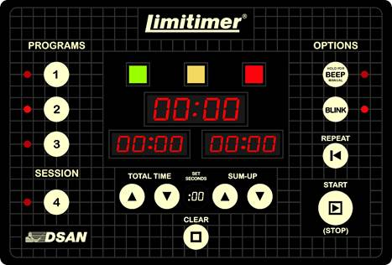
Speaker Timer
Notes:
AV is at all the Research Abstract rooms prior to start to help the moderators and the 1st few speakers to work the timer. If they’re not in the room, they should be in the hall. Contact them if you need them. They will make sure to reset the timer for15 minutes. (Green = 10 minutes, yellow = 5 minutes and red signals the end of the session.
Tell the speaker to press the Start button to begin the timer.

Slide 9
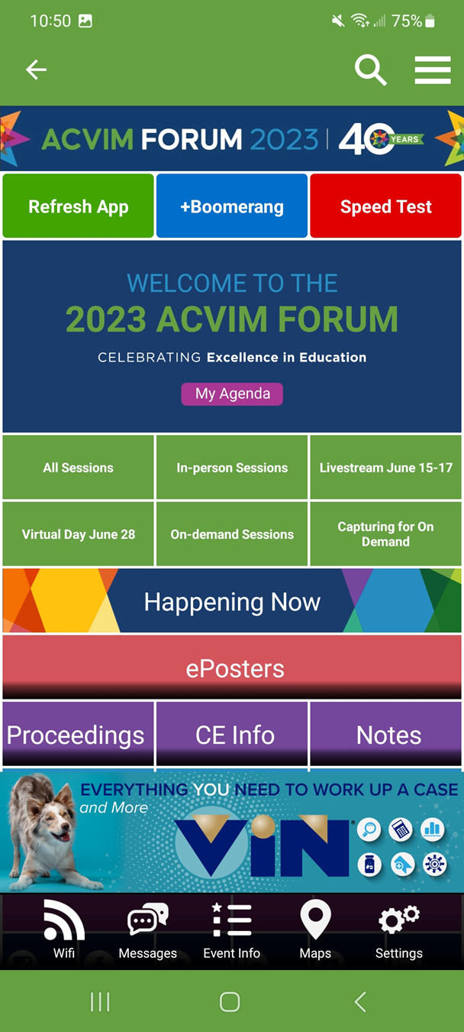
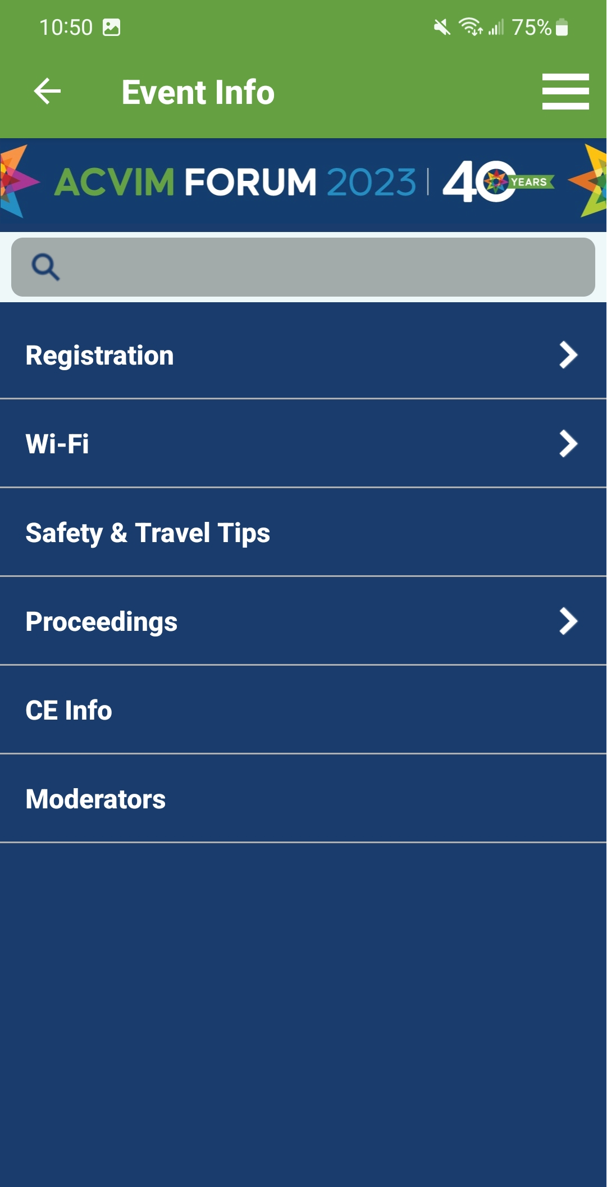
Resources
WEB PAGE
MOBILE APP
Please review the information on the Moderator and Research Abstract Information Web Page and bookmark the page for ease of use onsite.
Notes:
ACVIM staff has created many resources to help with your moderating experience. You can find the resources on the moderator webpage or the mobile app by clicking Event Info and select the Moderator link.
From here you can open moderator schedule, moderator instructions and more.

Slide 10
Resources
Questions?
Thank you for assisting with this essential duty and don’t forget to visit the Speaker Headquarters.
.
Notes:
If you have additional questions, stop in the Speaker Headquarters and speak with ACVIM staff and AV assistance. And remember, the Speaker Headquarters is for you too. You can stop by for a refreshment, to relax or to talk with staff.

Slide 11
For more information or if you have any questions please contact
AMANDA KLUDASCH
Conference Specialist
Amanda@ACVIM.org

