Slide 1
Scientific Session Moderator Training

Slide 2

Thank you!
Thank you for volunteering to moderate! You are a big part of making the onsite experience successful. We couldn’t do it without you!

Slide 3
Objectives
THE THREE “R’s”
This training is about:
Responsibilities of the session moderator
AV tech response and how to get in contact with them
Resources specifically for moderators

Slide 4
Responsibilities
BEFORE ARRIVAL
Make sure you have downloaded the mobile app
  Search for the “ACVIM” in your app store
  Install and open the app, then ‘search’ for “2023 ACVIM Forum”
  Log in with your Registration ID that can be found on your Forum registration confirmation email or
  printed on your conference badge
Locate or prepare a brief speaker introduction
  Review the speaker introduction (this should be an abbreviated version of a speaker biography and found in the mobile app)
  If no speaker biography is available, please plan to touch base with the speaker prior to the sessions start to confirm their details or contact them through the app

Slide 5
Responsibilities, continued…
BEFORE SESSION
Visit the Speaker Headquarters
  Located at the Pennsylvania Convention Center (Room 203B)
  Opens at 2:00 pm on Tuesday and 7:00 am Wednesday-Saturday
  Closes at 7:00 pm Tuesday-Friday and 11:30 am on Saturday
  Review moderator resources and collect speaker countdown cards
  Enjoy the amenities provided including power stations and beverages all day
Prepare for session(s)
  Ensure familiarity with moderator opening and closing remarks, including speaker(s) introductions
  Verify session sponsor on mobile app - if a session is sponsored, please include an acknowledgment in your introduction

Slide 6
Responsibilities, continued…
PRIOR TO SESSION START
Arrive at session room at least 15 minutes early
  Connect with AV if available in the room
  Visit computer at the podium and familiarize self with Technical Assistance Call Button on the keypad
Check-in with speaker(s)
  Confirm name pronunciations, clarify introduction flow for multi-speaker and panel sessions and confirm introduction(s)
  Confirm with speaker how tracking of time will be communicated
  Ask if questions will be allowed during or at end of presentation
    Indicate use of microphones in room to pose questions to capture the audio and recommend speaker repeat questions prior to answering

Slide 7
Responsibilities, continued…
PRIOR TO SESSION START
Check-in with speaker(s), continued…
  Speaker Reminders…
    the Q&A portion is included in the session timing and our goal is for a minimum of 50 minutes of speaker presentation time for each 1 hour session to meet RACE CE requirements
    to remind the audience to take a few minutes to complete the session evaluation through the mobile app
    confirm if their session is being recorded or livestreamed
      For all livestreaming sessions, an ACVIM staff member will be located in each streaming room for assistance

Slide 8
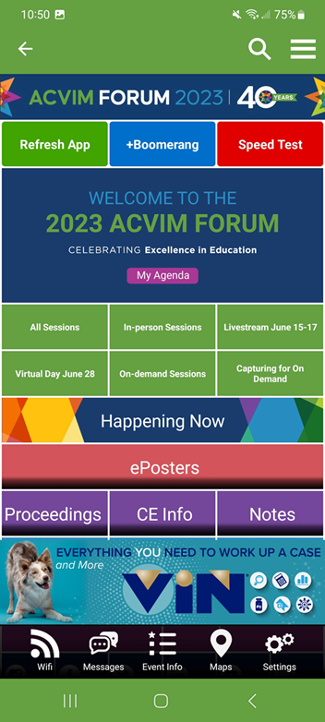
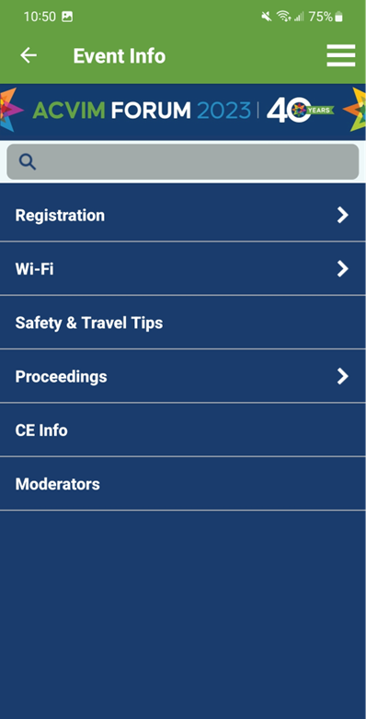

Resources
MOBILE APP

Slide 9
Responsibilities, continued…
AS SESSION BEGINS
As session begins to fill, encourage people to move toward the front of the room and move in to open up seats for people still coming into the room
Start the session as close to on-time as possible
  Confirm name pronunciations, clarify introduction flow for multi-speaker and panel sessions and confirm introduction(s)
  Confirm with speaker how tracking of time will be communicated
  Ask if questions will be allowed during or at end of presentation and indicate use of microphones in room to pose questions to capture the audio and recommend speaker repeat questions prior to answering
  Remind the speaker the Q&A portion is included in the session timing and to ask the audience to take a few minutes to complete the session evaluation through the mobile app

Slide 10
Troubleshooting
AV INFORMATION
Potential Issues
  AV issues
  Speaker concerns
  Room filling for potential overflow
    Notify AV of a potential overflow room
    Make an announcement for people to move in and up to fill to their comfort level
    AV staff will arrive to assist and direct people to overflow viewing if needed
  Please note: Room layouts cannot be changed – these are set to accommodate the rooms for the week. In addition, microphones have been assigned to the room based on the number of presenters.

Slide 11
Troubleshooting, continued…
HOW TO CONTACT AV
Our AV technicians can be contacted in a variety of ways:
  If you experience issues as the session is being set up, press the tech alert button on the laptop in the room. This will ask you to type in the issue and will immediately report the issue and room number to the AV team
  Check the hallway for a roaming AV technician stationed in the hallway outside of the presentation room
  Text or step outside the room and call our AV tech line at 215.385.3393 and notify of the room and issue

Slide 12
In Person
START OF SESSION – MODERATOR SCRIPT
Welcome
Introduce yourself as moderator (name only)
Announce title of session
Thank session sponsors (if any)
Ask attendees to turn cell phones to vibrate
Identify exits paths
If session is being livestreamed or content captured, remind attendees to utilize microphones when asking questions (you will see if it is livestreamed or content captured via the icon on mobile app). Or, the speaker will know.
Reminder to please fill out session evaluations
Introduce speaker(s)

Slide 13
In Person, continued
DURING THE SESSION
Troubleshoot as issues arise
Keep session on time
AFTER THE SESSION
Thank session sponsors and speakers
Remind attendees to complete session evaluations located in mobile app – this is critical to help the planning groups identify relevant content for the program.
Tell attendees to check out the Solutions Center (Thursdays and Fridays)

Slide 14
For more information or if you have any questions please contact:
AMANDA KLUDASCH
Conference Specialist
Amanda@ACVIM.org
Cell: 702.301.7257

